Slide 1

On The Grind

Slide 2
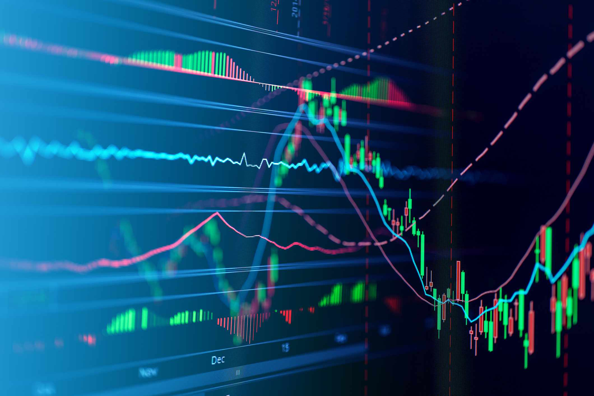
Contents
About us
Our team
Tech Stack
Implementation

Slide 3
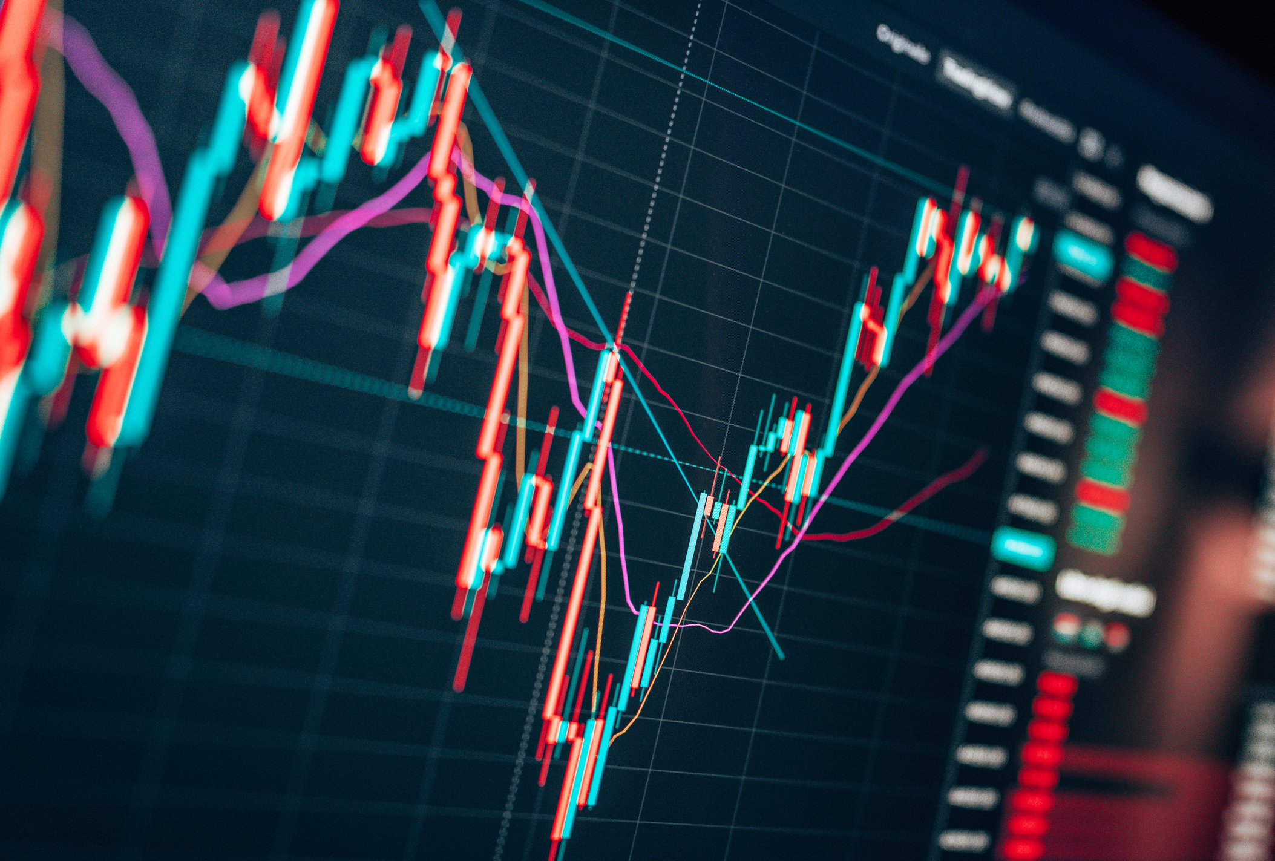
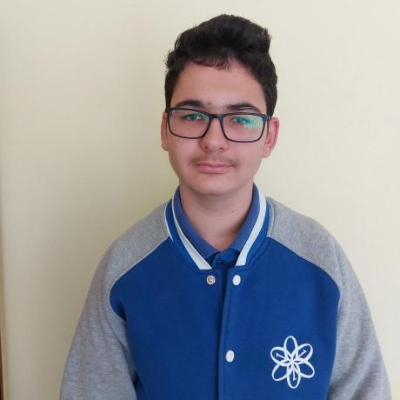
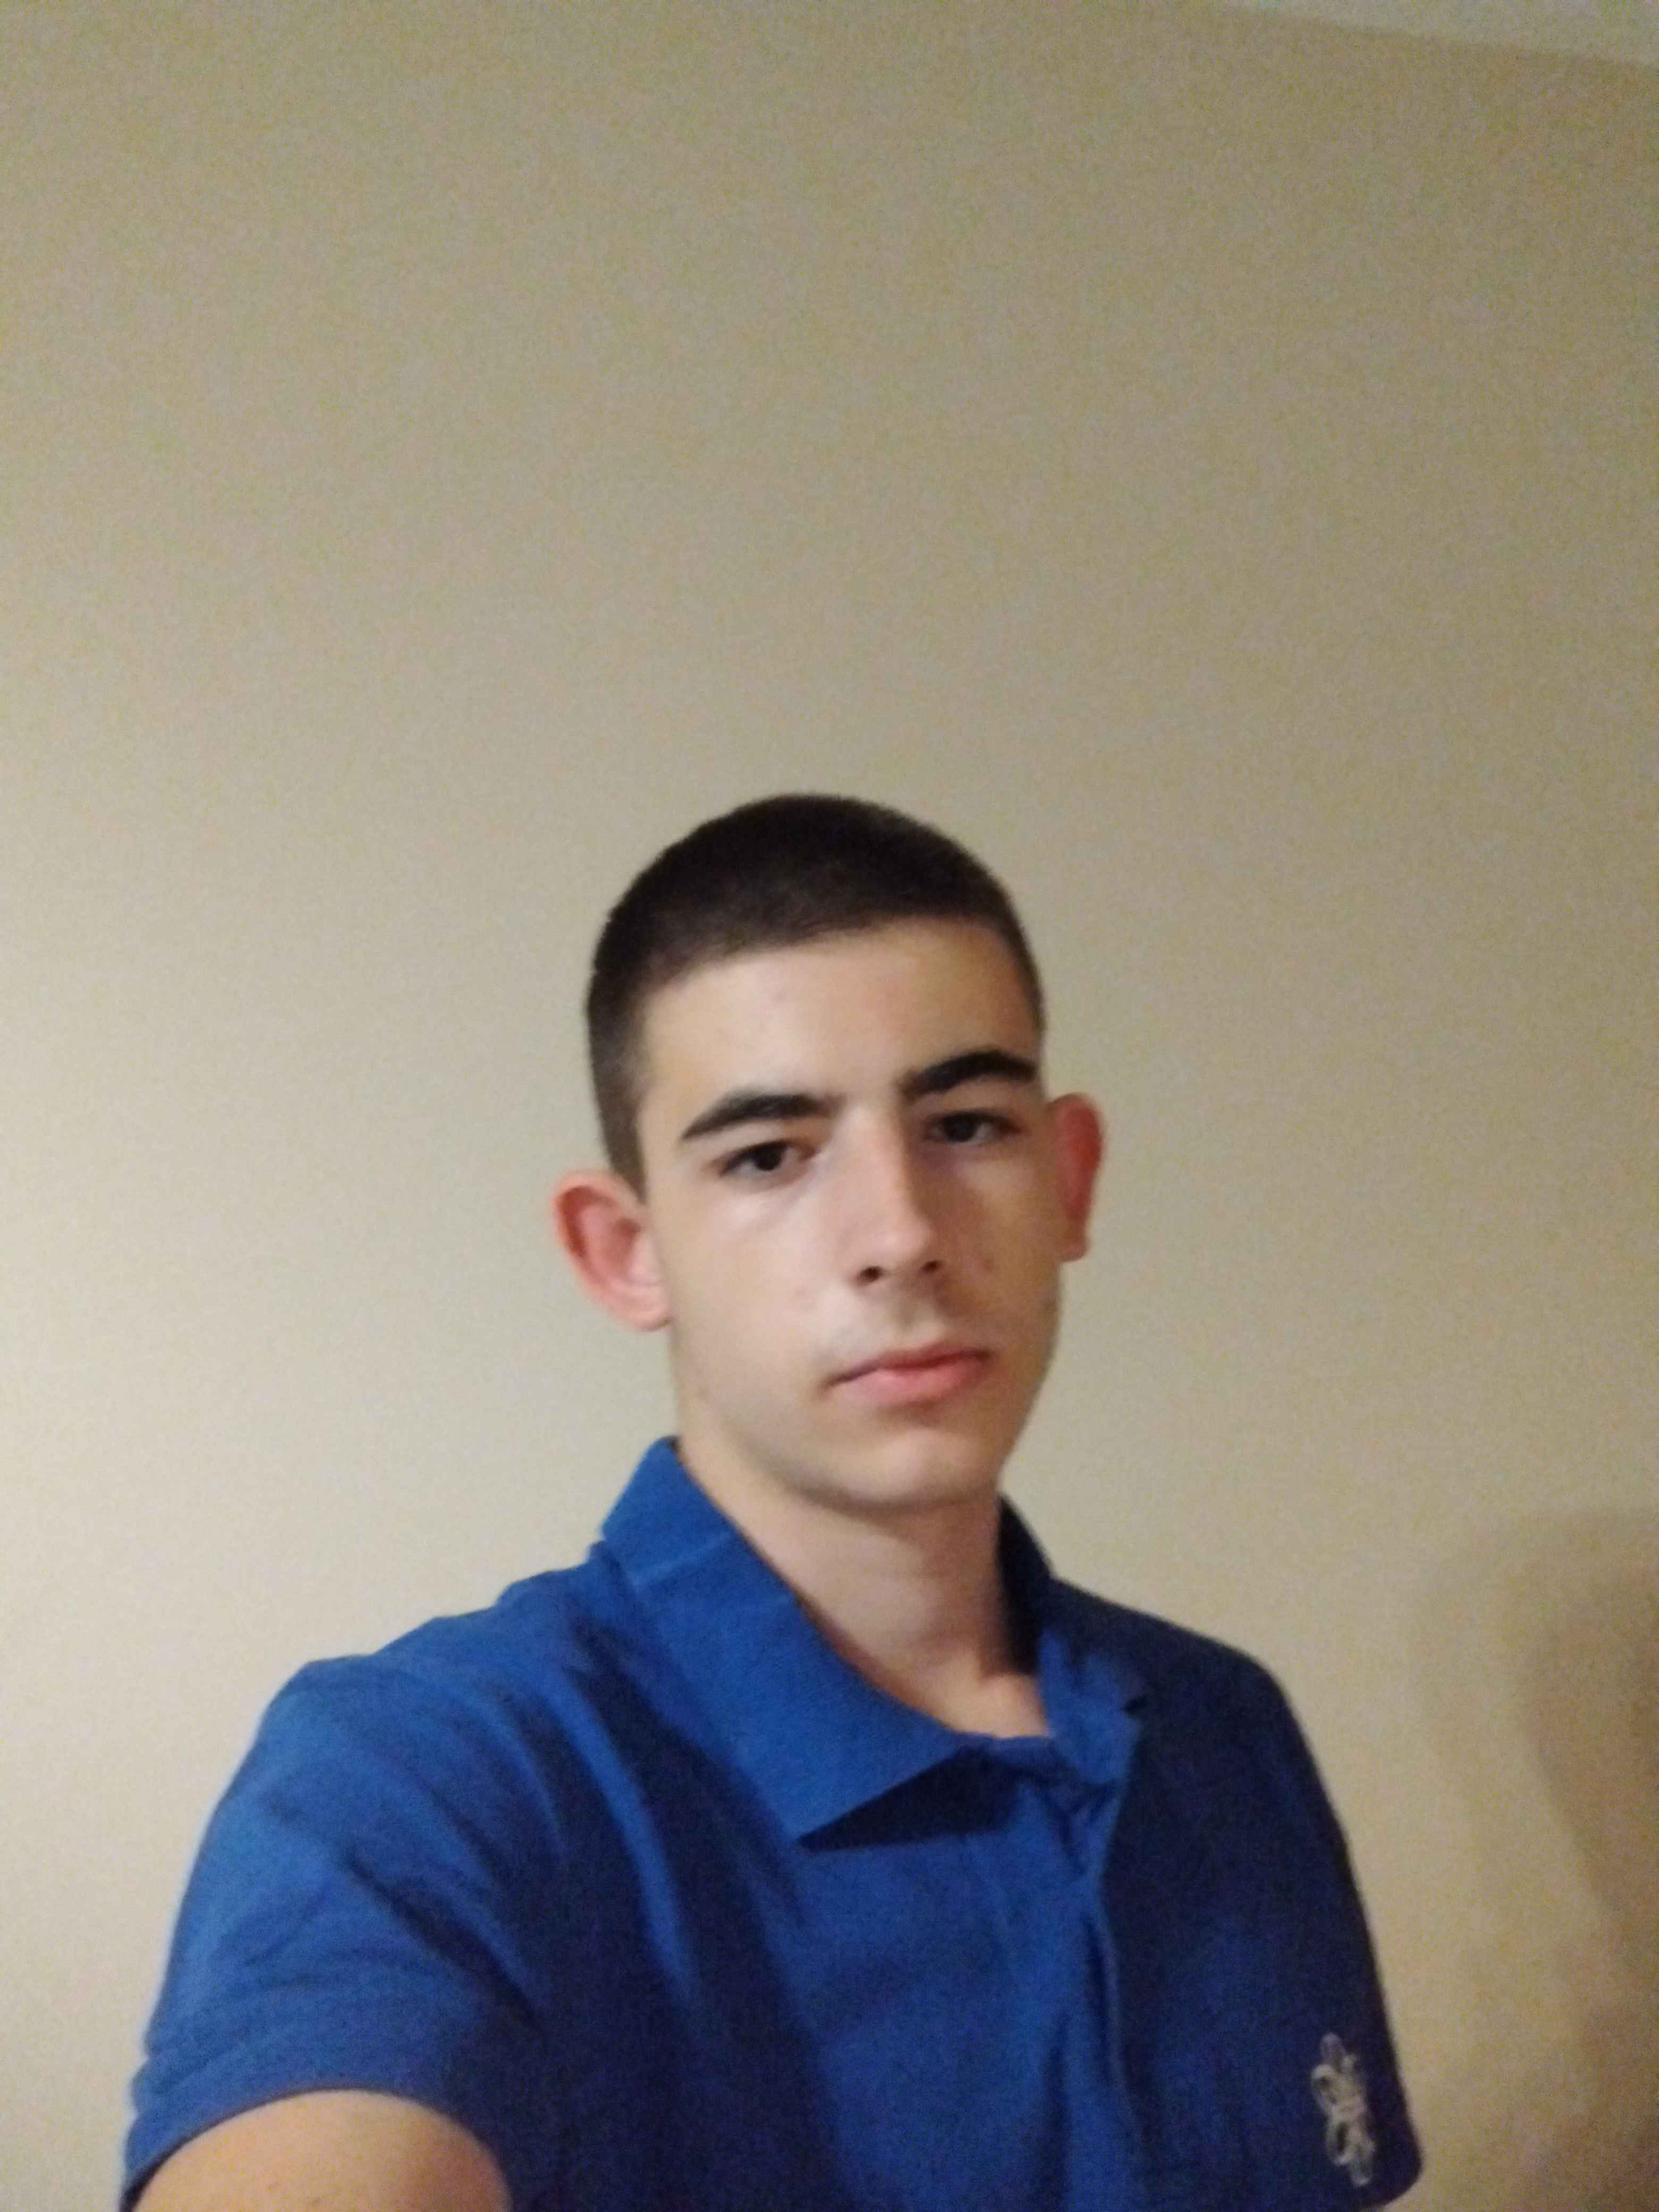
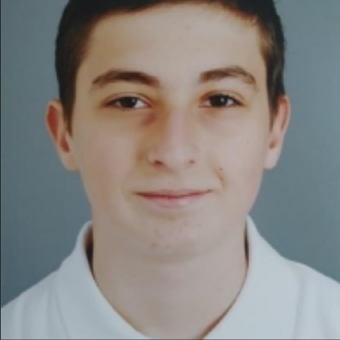
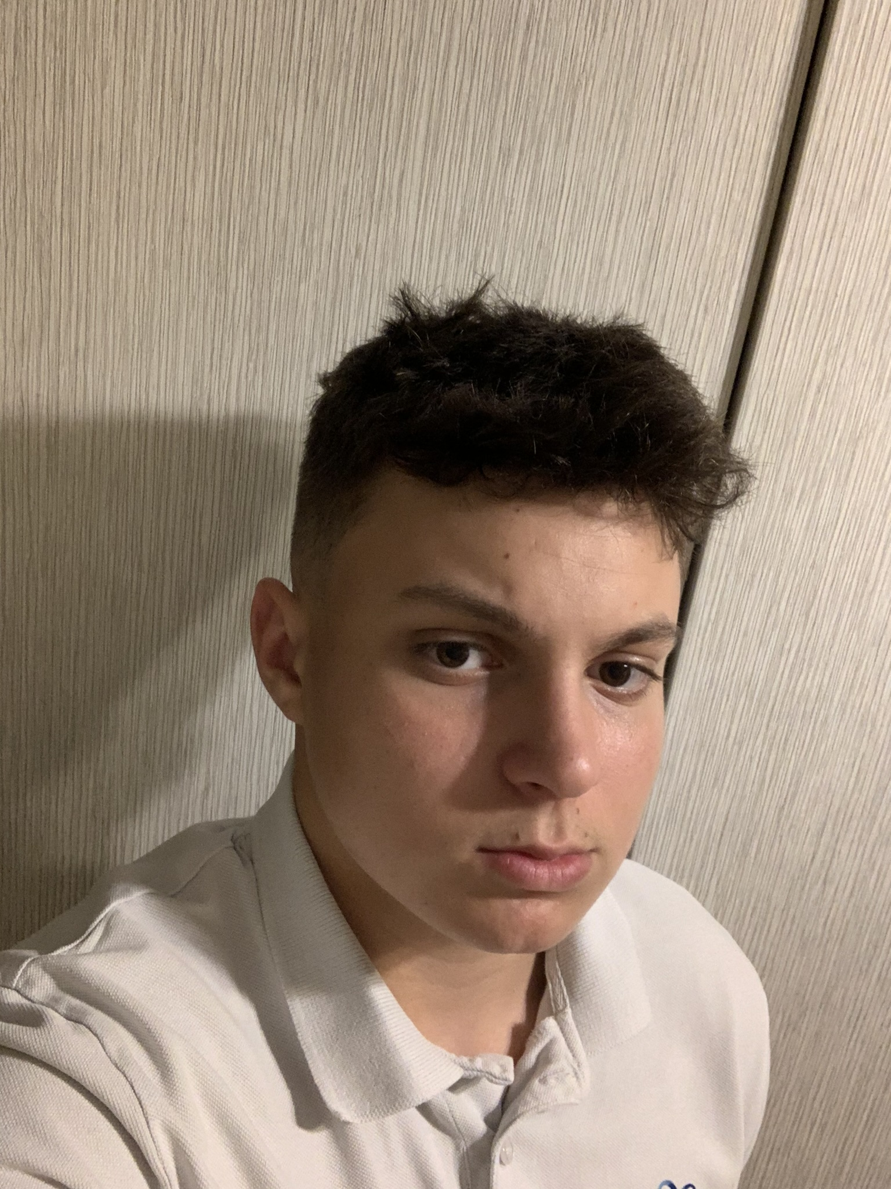
Our team
Stanislav Radev
Back-end Developer
Martin Dimitrov
Back-end Developer
Petar Dimitrov
Back-end Developer
Milko Barev Scrum Trainer

Slide 4
The idea
The goal of our project is to make free trading more accessible to everybody and see if you can make a living with it.

Slide 5








Tech Stack

Slide 6

Thanks for listening!
Let’s jump to the code!

